Slide 1
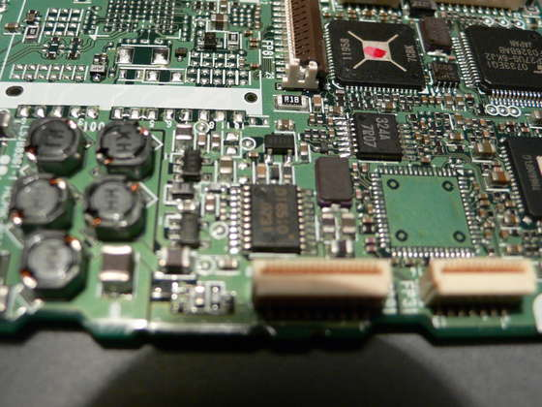
Embedded System
Spring, 2011
Lecture 9: I/O Programming
Eng. Wazen M. Shbair

Slide 2

Today’s Lecture
I/O Port Programming in PIC Microcontroller
I/O Bit Manipulation Programming
IUG- Embedded System

Slide 3
Objective
List all the ports of the PIC18
Describe the dual role of PIC18 pins
Code Assembly to use ports for input or output
Code PIC instructions for I/O handling
Code I/O bit-manipulation Programs for
PIC
Explain the bit addressability of PIC ports

Slide 4
I/O Port Programming in PIC18
PIC18 has many ports
  Depending on the family member
  Depending on the number of pins on the chip
Each port can be configured as input or output.
Bidirectional port
  Each port has some other functions
  Such as timer , ADC, interrupts and serial communication.
Some ports have 8 bits, while others have not

Slide 5
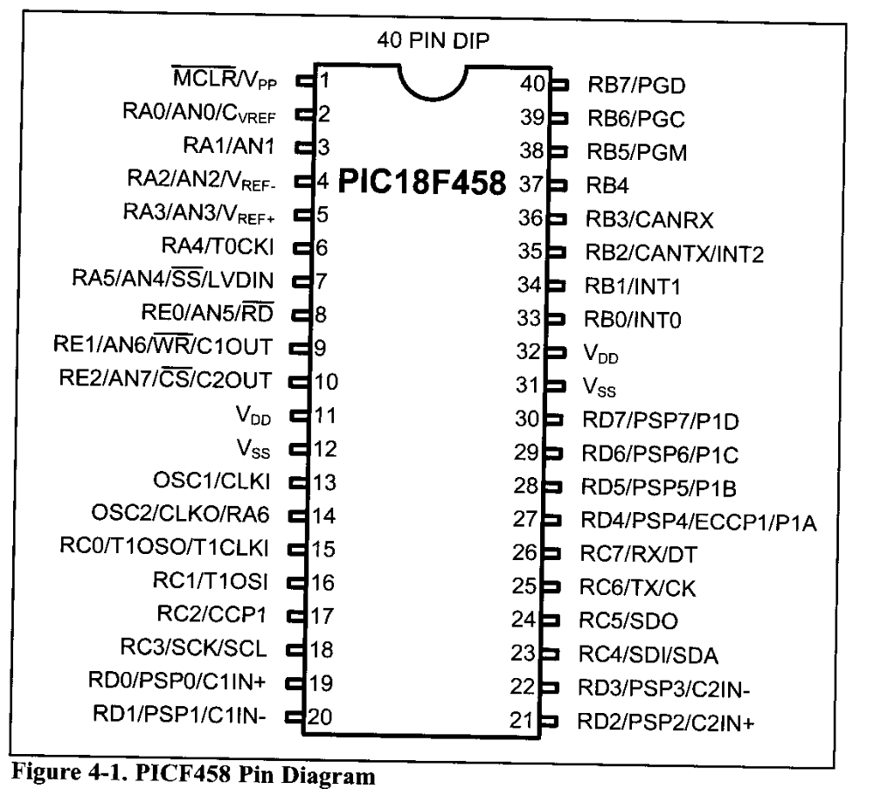
I/O Port Programming in PIC18

Slide 6
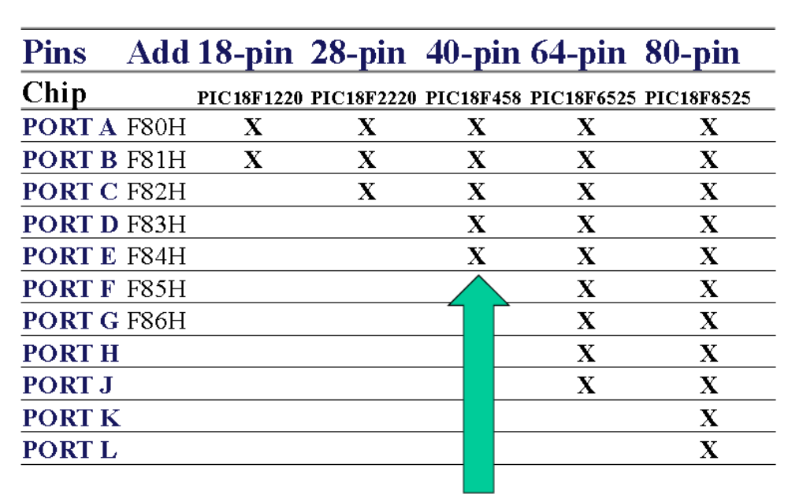

Slide 7
I/O SFR
Each port has three registers for its operation:
  TRIS register (Data Direction register)
    If the corresponding bit is 0 → Output
    If the corresponding bit is 1 → Input
  PORT register (reads the levels on the pins of the device)
  LAT register (output latch)
The Data Latch (LAT) register is useful for read-modify-write operations on the value that the I/O are driving.

Slide 8
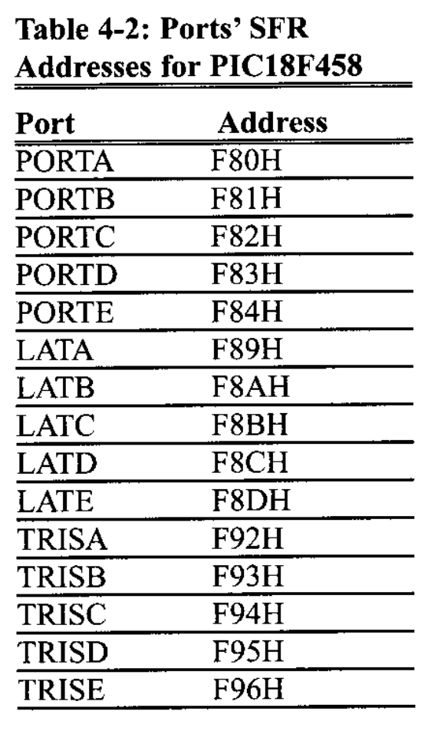
I/O SFR
PICC18F458 has 5 Ports
Upon reset, all ports are
configured as input.
TRISx register has 0FFH

Slide 9
Port A
PORTA is a 7-bit wide, bidirectional port.
The corresponding Data Direction register is TRISA.
  Setting a TRISA bit (= 1) will make the corresponding PORTA pin an input
  Clearing a TRISA bit (= 0) will make the corresponding PORTA pin an output
On a Power-on Reset, these pins are configured as inputs and read as ‘0’

Slide 10
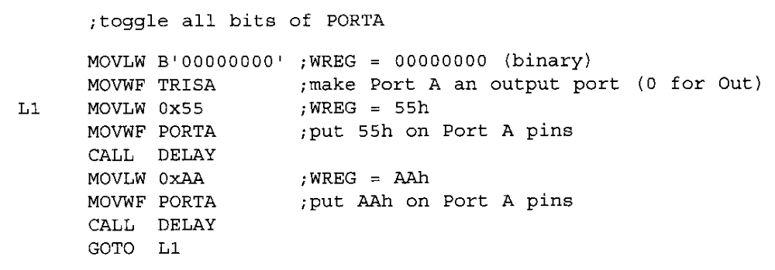
Example: Port A as Output

Slide 11
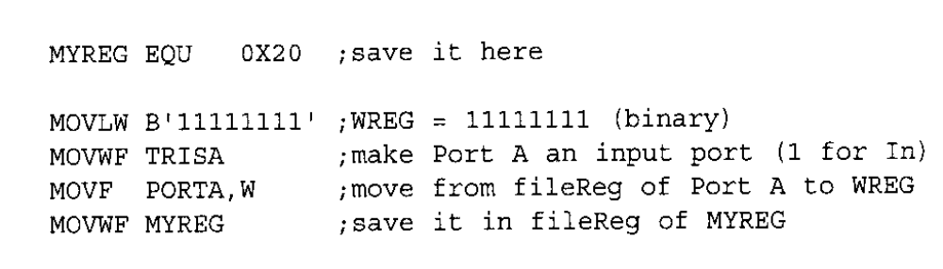
Example: Port A as Input

Slide 12
PORT B, PORT C, PORT D and PORT E
PORTB is 8 pins
PORTC is 8 pins
PORTD is 8 pins
PORTE is 3 pins

Slide 13
Read followed by write operation
Be carful
  Don’t have two I/O operations one right after the others.
Data Dependency
  A NOP is needed to make that data is written in the WREG before it read for outputting to PortB

Slide 14
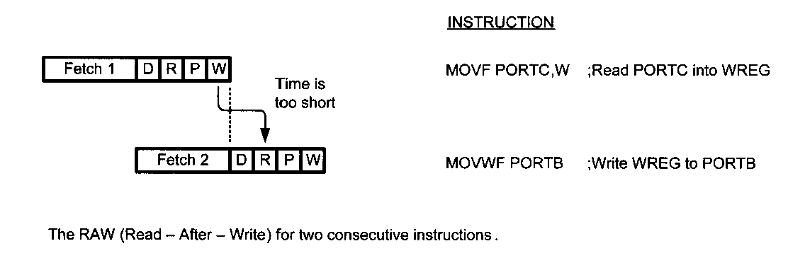
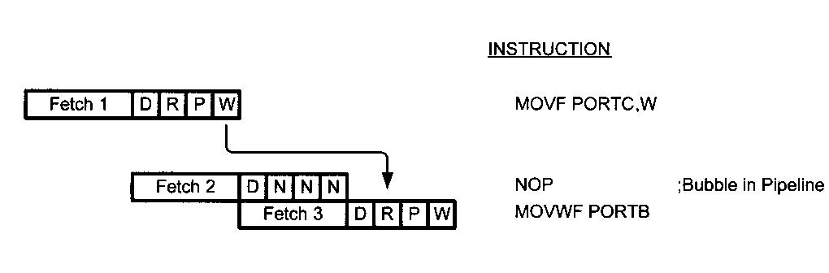

Slide 15
I/O Bit Manipulation Programming
I/O ports and bit-addressability
Monitoring a single bit
Reading a single bit

Slide 16
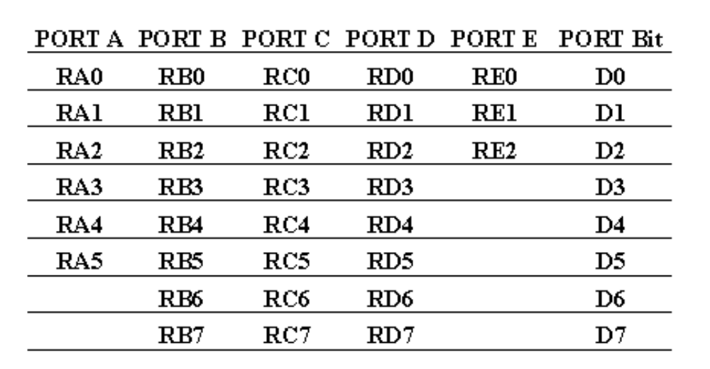
I/O ports and bit addressability

Slide 17
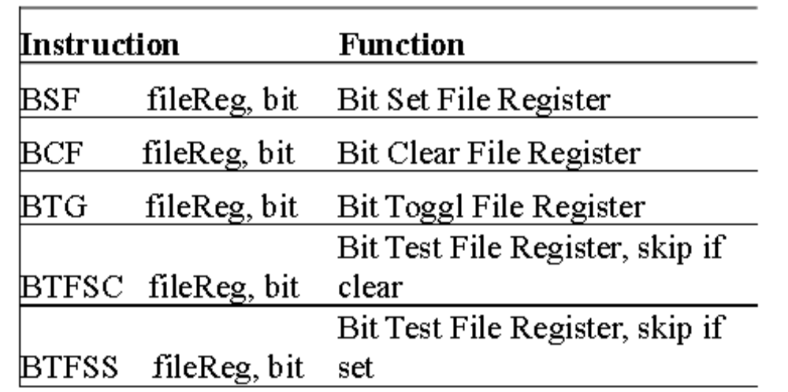
Bit Oriented Instruction for PIC18

Slide 18
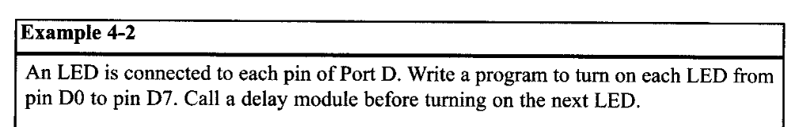
BSF (bit set fileReg)
Used to set HIGH for a single bit in fileReg
The Syntax :
  BSF fileReg, bit_num

Slide 19
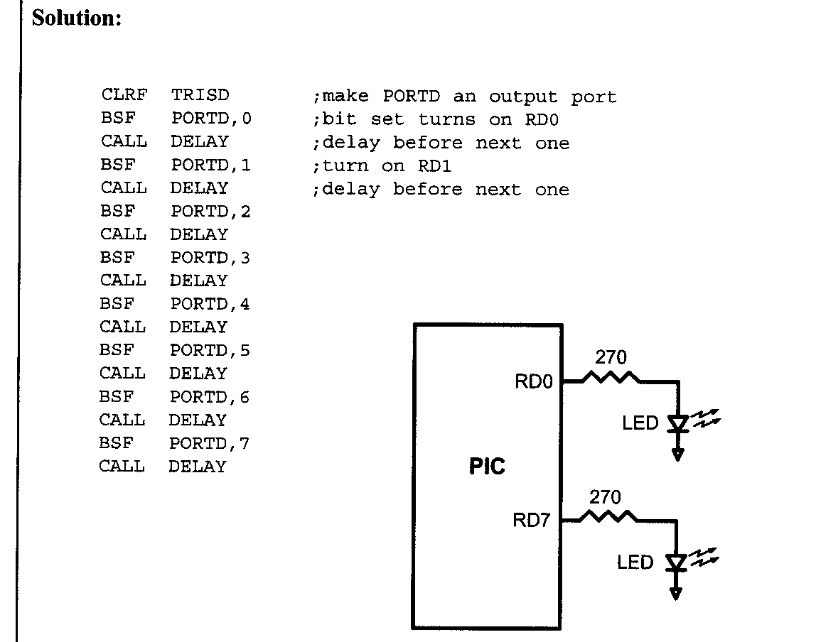

Slide 20
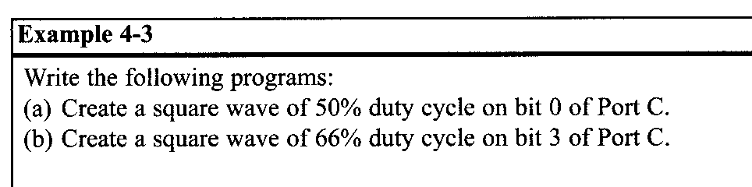
BCF(bit clear fileReg)
Used to clear a sigle bit of given fileReg
The Syntax:
  BCF fileReg, bit_number

Slide 21
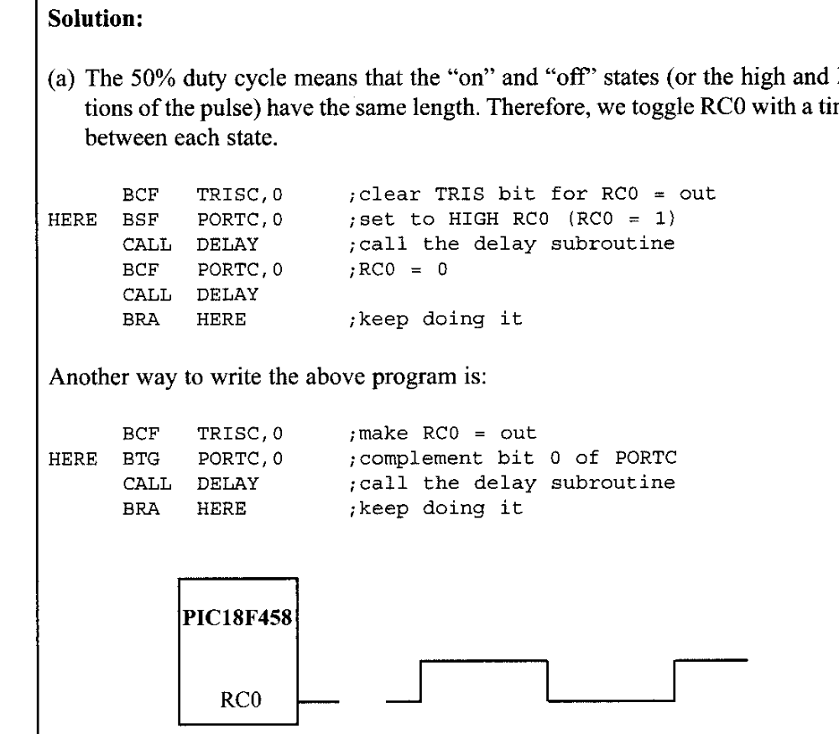

Slide 22
Checking an input pin
To make decisions base on the status of a given bit in the file register, we use:
  BTFSC (bit test fileReg skip if clear)
  BTFSS (bit test fileReg skip if set)
These single-bit instruction allow to monitor a single bit and make decision whether it is 0 or 1.

Slide 23
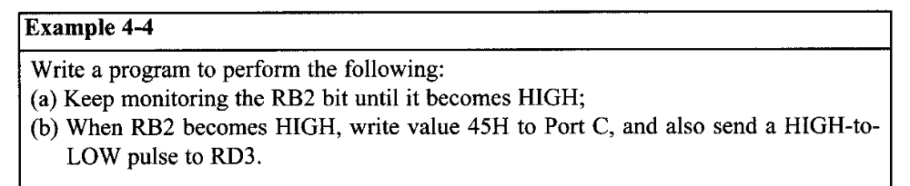
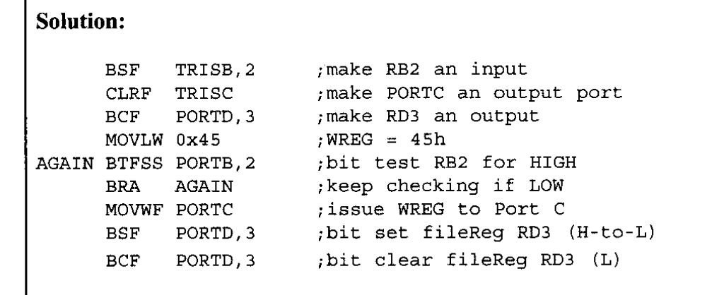

Slide 24
Reading a single bit
We can use bit test instruction to read the status of the single bit and send it to another bit of save it

Slide 25
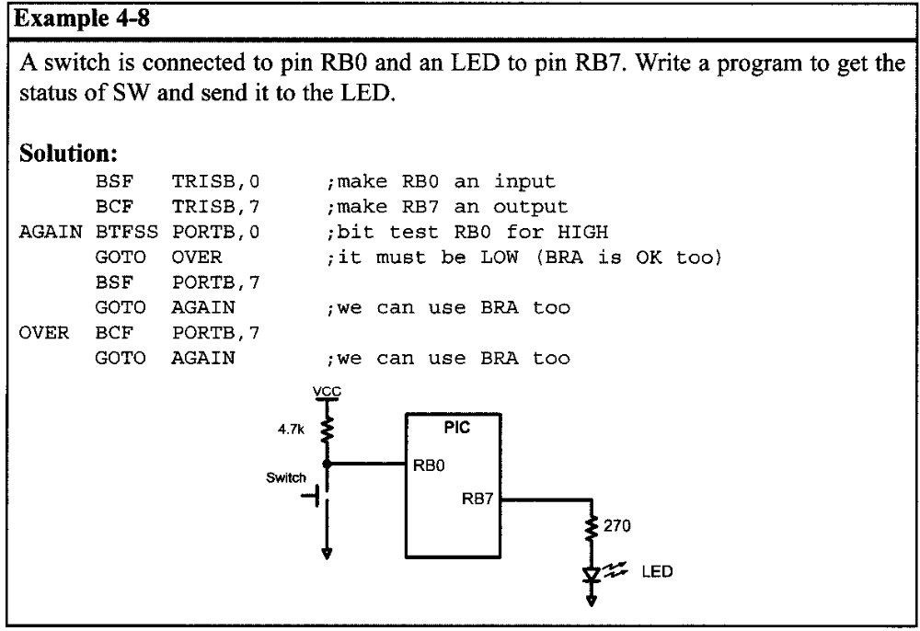

Slide 26
Reading input pins VS. LATx port
There are two possibilities to read port’s value
  Through reading the status of the input pin
  Through reading the internal latch of the LAT register.
  Some instructions do that
    The action is
      The instruction read the latch instead of the pin
      Execute the instruction
      Write back the result to the Latch
      The data on the pins are changed only if the TRISx
      The PIC uCs bits are cleared.

Slide 27
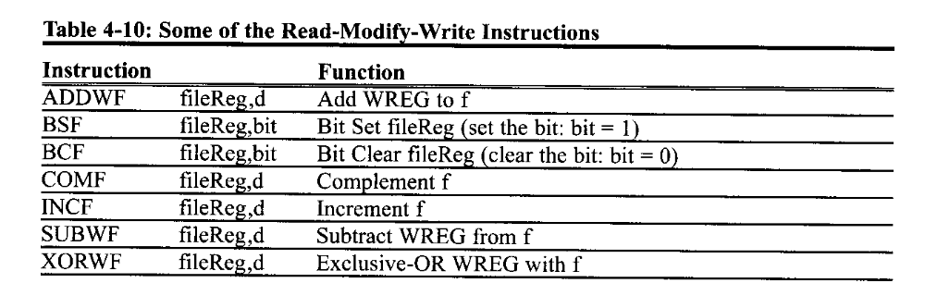
Reading input pins VS. LATx port

Slide 28
References
Jie Hu , ECE692 Embedded Computing Systems , Fall 2010.
PIC Microcontroller And Embedded Systems: using Assembly and C for PIC 18, M. Mazidi, R. McKinlay and D. Causey, Prentice Fall, 2008.
Eng. Husam Alzaq, Embedded System Course, IUG, 2010
IUG- Embedded System

